Slide 1

Stability
MTH 564 – Mathematical Modeling

Slide 2
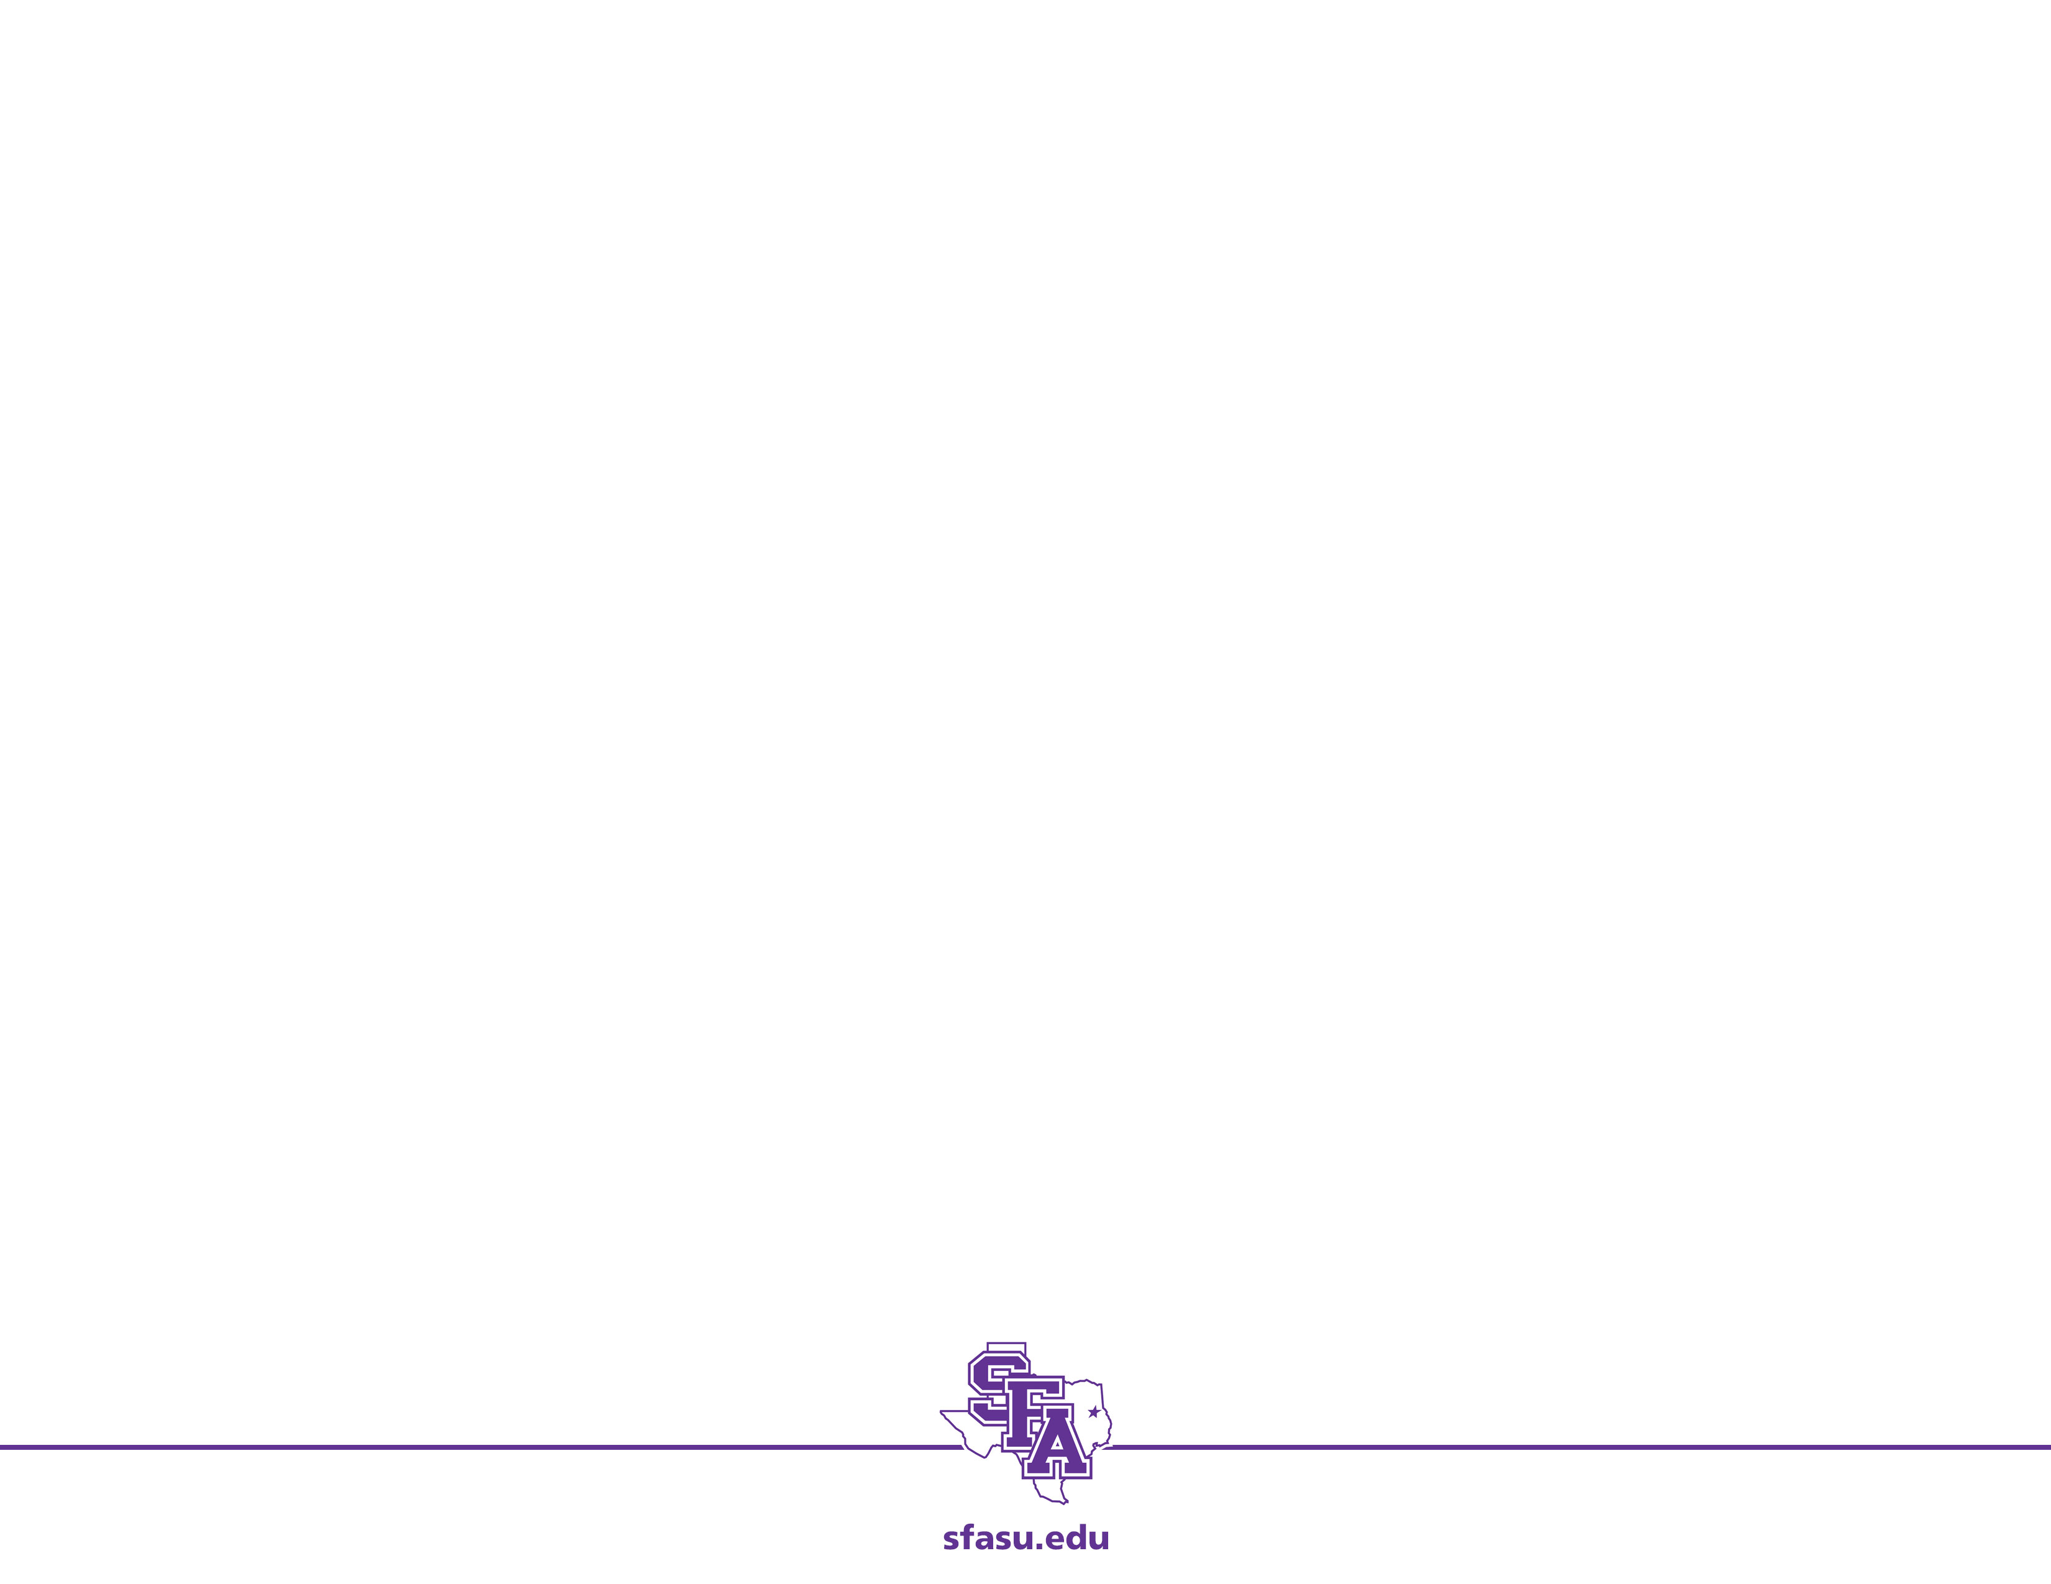
Example: Whales
The blue whale and the fin whale are two similar species that inhabit the same areas. The intrinsic growth rate is estimated at 5% per year for the blue whale and 8% per year for the fin whale. The environment carrying capacity is estimated at 150,000 for the blue whale and 400,000 for the fin whale. The extent to which the whales compete is unknown. In the last 100 years intense harvesting has reduced the whale population to around 5,000 blue whales and 70,000 fin whales. Will the blue whales become extinct?

Slide 3
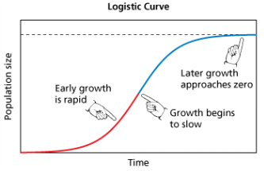
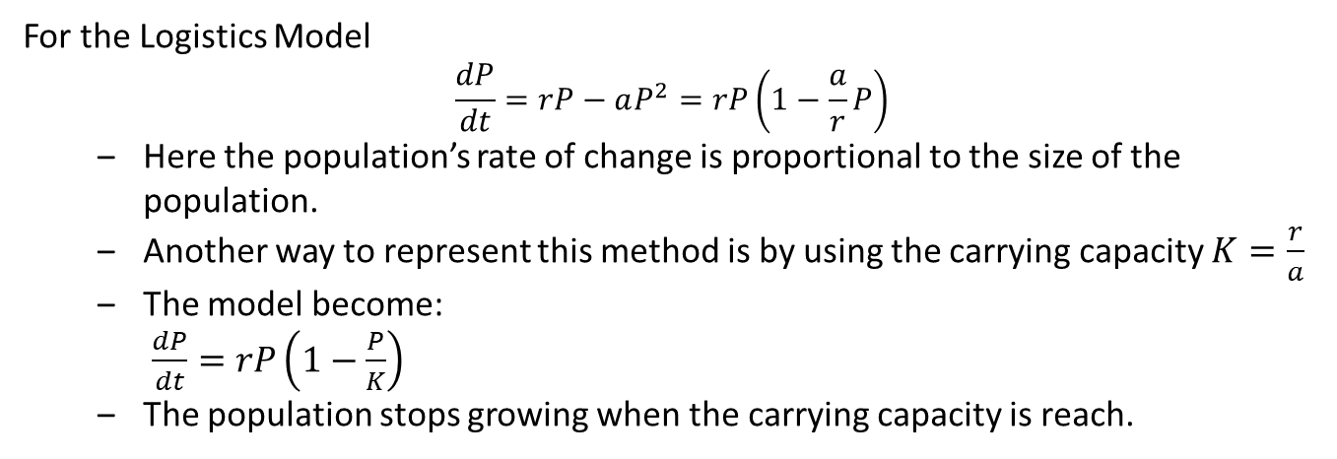
Recall: Logistics Population Models
For the Logistics Model $$\frac{dP}{dt}=rP−aP^{2}=rP\left(1−\frac{a}{r}P\right)$$
Here the population’s rate of change is proportional to the size of the population.
Another way to represent this method is by using the carrying capacity $K=\frac{r}{a}$
The model become: $\frac{dP}{dt}=rP\left(1−\frac{P}{K}\right)$
The population stops growing when the carrying capacity is reach.
Carrying Capacity(K)

Slide 4
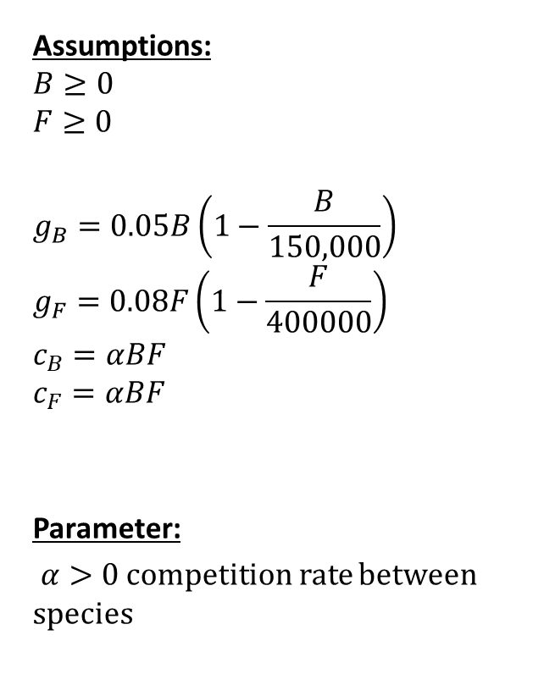
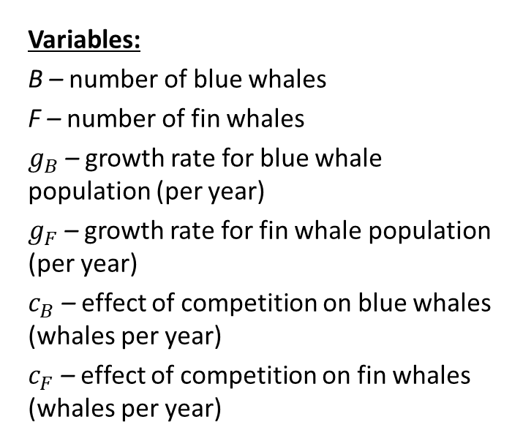
Step 1: Ask the question.
Variables:
B – number of blue whales
F – number of fin whales
$g_{B}$ – growth rate for blue whale population (per year)
$g_{F}$ – growth rate for fin whale population (per year)
$c_{B}$ – effect of competition on blue whales (whales per year)
$c_{F}$ – effect of competition on fin whales (whales per year)
Assumptions:
$$B≥0$$
$$F≥0$$
$$g_{B}=0.05B\left(1−\frac{B}{150,000}\right)$$
$$g_{F}=0.08F\left(1−\frac{F}{400000}\right)$$
$$c_{B}=αBF$$
$$c_{F}=αBF$$
Parameter:
$α>0$ competition rate between species
Objective
Determine whether the system can reach stable equilibrium starting from B = 5,000 and F = 70,000.

Slide 5
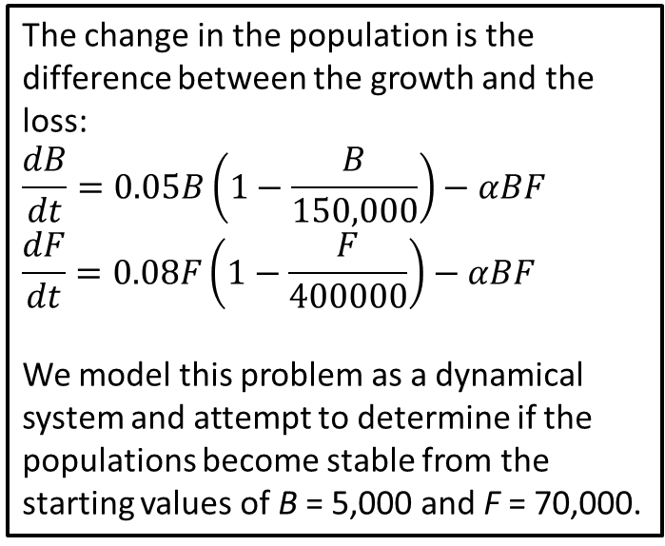
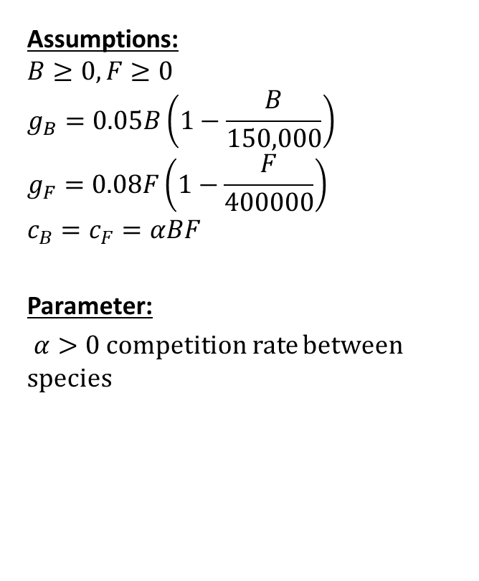
Step 2: Select the modeling approach
Assumptions:
$$B≥0, F≥0$$
$$g_{B}=0.05B\left(1−\frac{B}{150,000}\right)$$
$$g_{F}=0.08F\left(1−\frac{F}{400000}\right)$$
$$c_{B}=c_{F}=αBF$$
Parameter:
$α>0$ competition rate between species
The change in the population is the difference between the growth and the loss:
$$\frac{dB}{dt}=0.05B\left(1−\frac{B}{150,000}\right)−αBF$$
$$\frac{dF}{dt}=0.08F\left(1−\frac{F}{400000}\right)−αBF$$
We model this problem as a dynamical system and attempt to determine if the populations become stable from the starting values of B = 5,000 and F = 70,000.
Objective
Determine whether the system can reach stable equilibrium starting from B = 5,000 and F = 70,000.

Slide 6
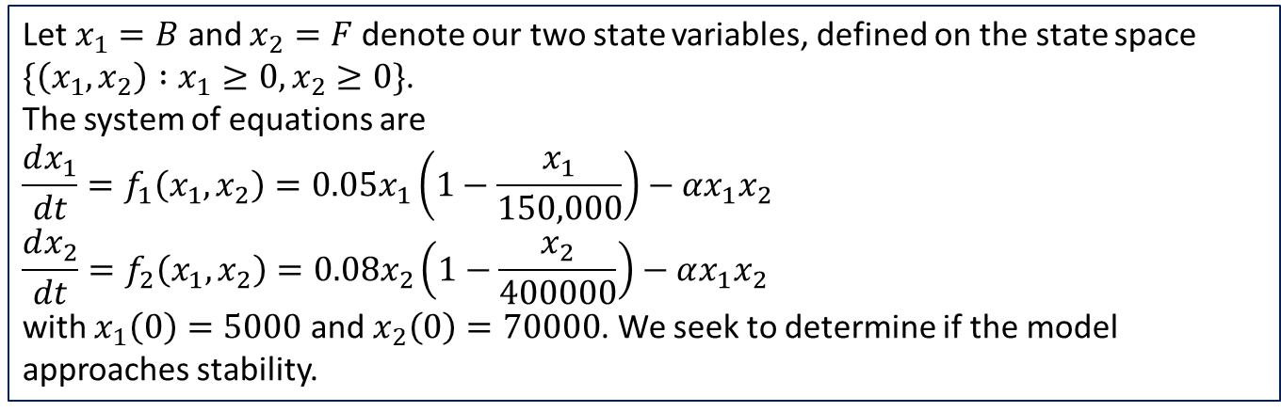
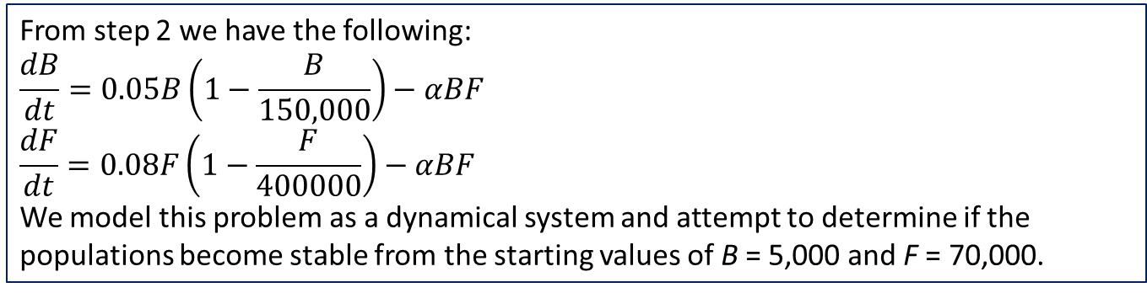
Step 3: Formulate the model
From step 2 we have the following:
$$\frac{dB}{dt}=0.05B\left(1−\frac{B}{150,000}\right)−αBF$$
$$\frac{dF}{dt}=0.08F\left(1−\frac{F}{400000}\right)−αBF$$
We model this problem as a dynamical system and attempt to determine if the populations become stable from the starting values of B = 5,000 and F = 70,000.
Let $x_{1}=B$ and $x_{2}=F$ denote our two state variables, defined on the state space
$\{\left(x_{1},x_{2}\right) :x_{1}≥0, x_{2}≥0\}$.
The system of equations are
$$\frac{dx_{1}}{dt}=f_{1}\left(x_{1},x_{2}\right)=0.05x_{1}\left(1−\frac{x_{1}}{150,000}\right)−αx_{1}x_{2}$$
$$\frac{dx_{2}}{dt}=f_{2}\left(x_{1},x_{2}\right)=0.08x_{2}\left(1−\frac{x_{2}}{400000}\right)−αx_{1}x_{2}$$
with $x_{1}\left(0\right)=5000$ and $x_{2}\left(0\right)=70000$. We seek to determine if the model approaches stability.

Slide 7
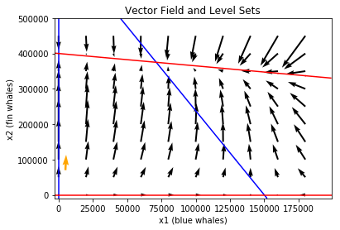
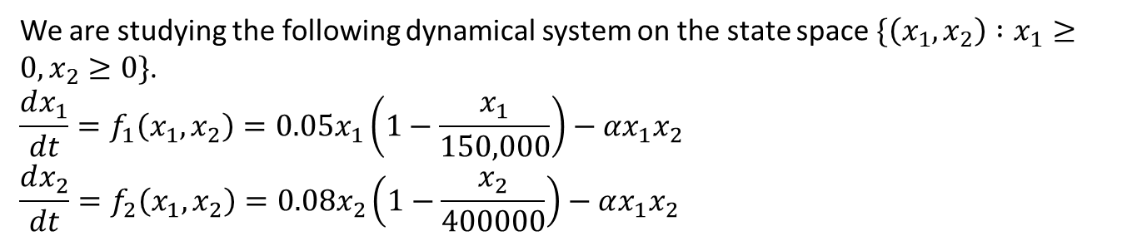
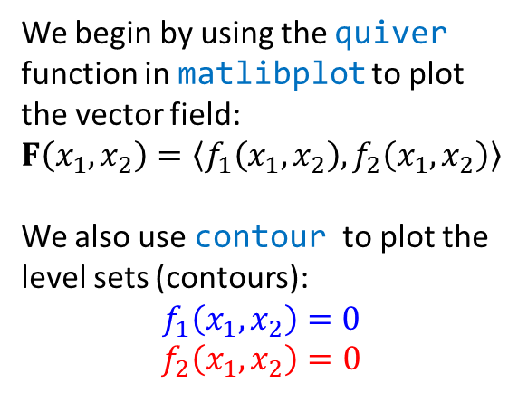
Step 4: Solve the Problem
We are studying the following dynamical system on the state space $\{\left(x_{1},x_{2}\right) :x_{1}≥0, x_{2}≥0\}$.
$$\frac{dx_{1}}{dt}=f_{1}\left(x_{1},x_{2}\right)=0.05x_{1}\left(1−\frac{x_{1}}{150,000}\right)−αx_{1}x_{2}$$
$$\frac{dx_{2}}{dt}=f_{2}\left(x_{1},x_{2}\right)=0.08x_{2}\left(1−\frac{x_{2}}{400000}\right)−αx_{1}x_{2}$$
We begin by using the quiver function in matlibplot to plot the vector field:
$$F\left(x_{1},x_{2}\right)=〈f_{1}\left(x_{1},x_{2}\right), f_{2}\left(x_{1},x_{2}\right)〉$$
We also use contour to plot the
level sets (contours):
$$f_{1}\left(x_{1},x_{2}\right)=0$$
$$f_{2}\left(x_{1},x_{2}\right)=0$$
Notes:
Note: the orange arrow is the vector at the initial condition of (5000,70000)

Slide 8
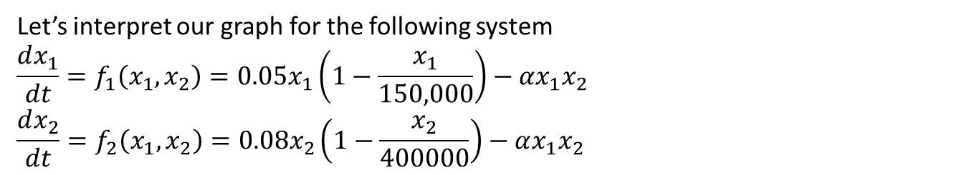
Step 4: Graph Interpretation
Let’s interpret our graph for the following system
$$\frac{dx_{1}}{dt}=f_{1}\left(x_{1},x_{2}\right)=0.05x_{1}\left(1−\frac{x_{1}}{150,000}\right)−αx_{1}x_{2}$$
$$\frac{dx_{2}}{dt}=f_{2}\left(x_{1},x_{2}\right)=0.08x_{2}\left(1−\frac{x_{2}}{400000}\right)−αx_{1}x_{2}$$
The Fin Whales approach carrying capacity of 400,000 if no Blue Whales are present.
The Blue Whales approach carrying capacity of 150,00 if no Fin Whales are present.
At other locations populations approach equilibrium found at the intersection of the two level sets.

Slide 9
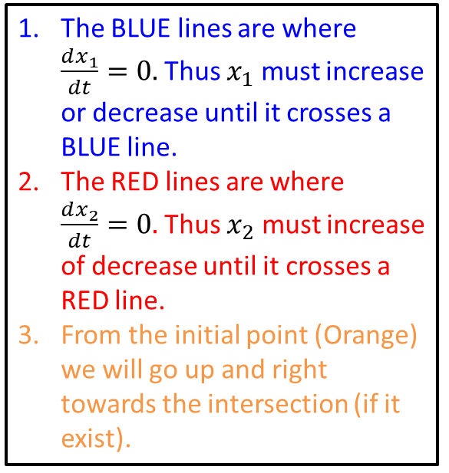
Step 4: Graph Interpretation (More)
Let’s interpret our graph for the following system
$$\frac{dx_{1}}{dt}=f_{1}\left(x_{1},x_{2}\right)=0.05x_{1}\left(1−\frac{x_{1}}{150,000}\right)−αx_{1}x_{2}$$
$$\frac{dx_{2}}{dt}=f_{2}\left(x_{1},x_{2}\right)=0.08x_{2}\left(1−\frac{x_{2}}{400000}\right)−αx_{1}x_{2}$$
The BLUE lines are where $\frac{dx_{1}}{dt}=0.$ Thus $x_{1}$ must increase or decrease until it crosses a BLUE line.
The RED lines are where $\frac{dx_{2}}{dt}=0.$ Thus $x_{2}$ must increase of decrease until it crosses a RED line.
From the initial point (Orange) we will go up and right towards the intersection (if it exist).

Slide 10
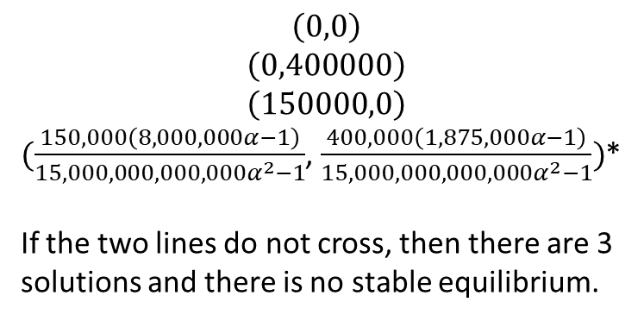
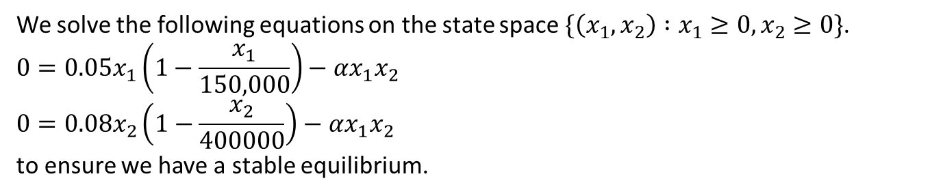
Step 4: Find Equilibriums
We solve the following equations on the state space $\{\left(x_{1},x_{2}\right) :x_{1}≥0, x_{2}≥0\}$.
$$0=0.05x_{1}\left(1−\frac{x_{1}}{150,000}\right)−αx_{1}x_{2}$$
$$0=0.08x_{2}\left(1−\frac{x_{2}}{400000}\right)−αx_{1}x_{2}$$
to ensure we have a stable equilibrium.
Solving these equations either by hand or using solve function in sympy we get the following solutions:
$$\left(0,0\right)$$
$$\left(0,400000\right)$$
$$\left(150000,0\right)$$
$(\frac{150,000\left(8,000,000α−1\right)}{15,000,000,000,000α^{2}−1}$, $\frac{400,000\left(1,875,000α−1\right)}{15,000,000,000,000α^{2}−1})$*
If the two lines do not cross, then there are 3 solutions and there is no stable equilibrium.
Notes:
This could mean one of the whales die out or it could mean there is back and forth.
The orange arrow represents our initial condition of (5000,70000)

Slide 11
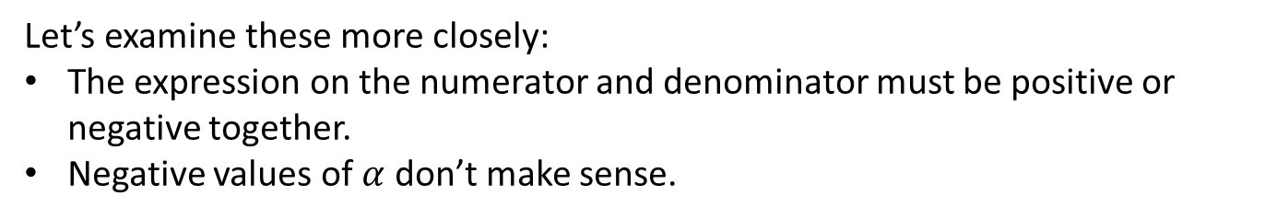
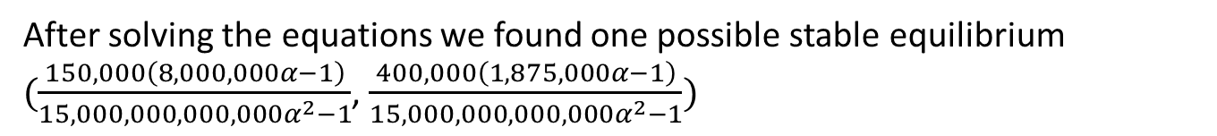
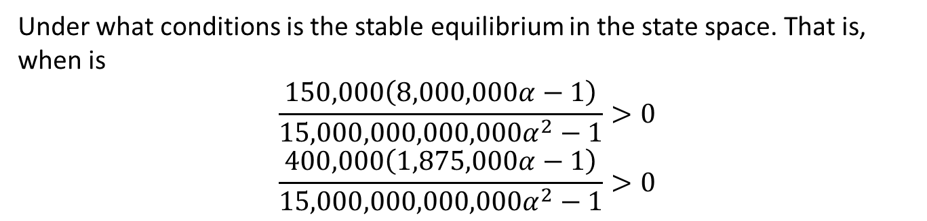
Step 4: Equilibrium Existence
After solving the equations we found one possible stable equilibrium
$(\frac{150,000\left(8,000,000α−1\right)}{15,000,000,000,000α^{2}−1}$, $\frac{400,000\left(1,875,000α−1\right)}{15,000,000,000,000α^{2}−1})$
Under what conditions is the stable equilibrium in the state space. That is, when is
$$\frac{150,000\left(8,000,000α−1\right)}{15,000,000,000,000α^{2}−1}>0$$
$$\frac{400,000\left(1,875,000α−1\right)}{15,000,000,000,000α^{2}−1}>0$$
Let’s examine these more closely:
The expression on the numerator and denominator must be positive or negative together.
Negative values of $α$ don’t make sense.

Slide 12
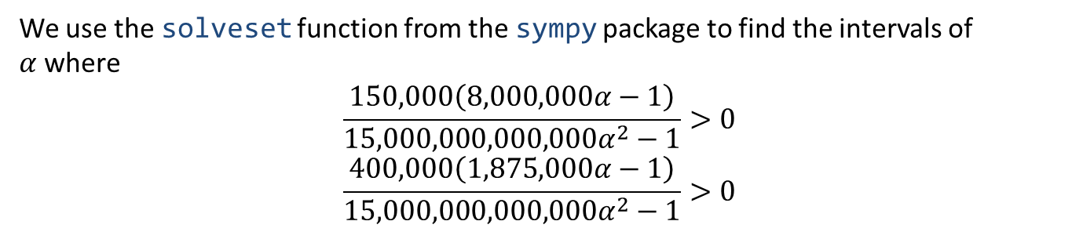
Step 4: Equilibrium Existence
We use the solveset function from the sympy package to find the intervals of $α$where
$$\frac{150,000\left(8,000,000α−1\right)}{15,000,000,000,000α^{2}−1}>0$$
$$\frac{400,000\left(1,875,000α−1\right)}{15,000,000,000,000α^{2}−1}>0$$
The first equation is positive on
$$\left(−2.582×{10}^{−7}, 1.25×{10}^{−7}\right)∪(2.582×{10}^{−7}, ∞)$$
The second equation is positive on
$$\left(−2.582×{10}^{−7}, 2.582×{10}^{−7}\right)∪(5.333×{10}^{−7}, ∞)$$
Taking the intersection of the intervals above and $α≥0$ we get
$$[0, 1.25×{10}^{−7})∪(5.333×{10}^{−7}, ∞)$$

Slide 13
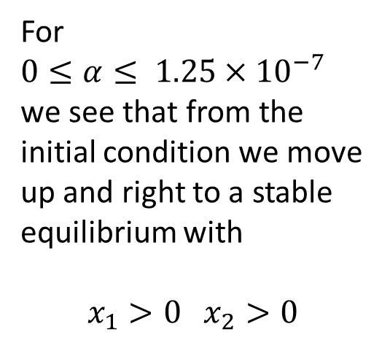
Step 4: Solve the Problem
We consider our initial conditions under both the scenarios of
$0≤α≤ 1.25×{10}^{−7} and α≥5.333×{10}^{−7}$
For $0≤α≤ 1.25×{10}^{−7}$ we see that from the initial condition we move up and right to a stable equilibrium with
$$x_{1}>0 x_{2}>0$$

Slide 14
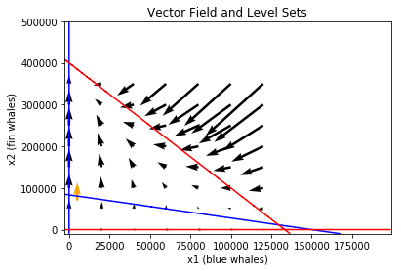
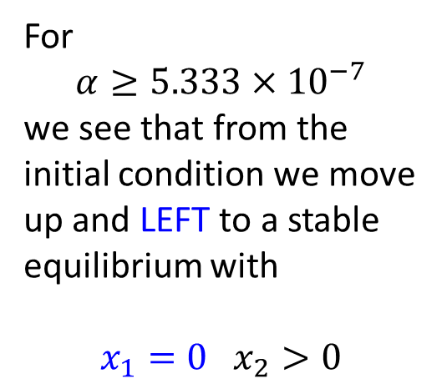
Step 4: Solve the Problem
We consider our initial conditions under both the scenarios of
$0≤α≤ 1.25×{10}^{−7} and α≥5.333×{10}^{−7}$
For $$α≥5.333×{10}^{−7}$$
we see that from the initial condition we move up and LEFT to a stable equilibrium with
$$x_{1}=0 x_{2}>0$$

Slide 15
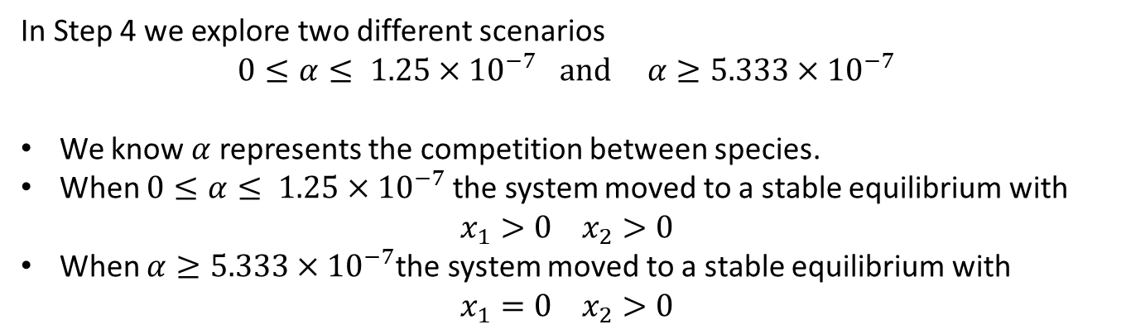
Step 5: Answer the question
In Step 4 we explore two different scenarios $$0≤α≤ 1.25×{10}^{−7} and α≥5.333×{10}^{−7}$$
We know $α$ represents the competition between species.
When $0≤α≤ 1.25×{10}^{−7}$the system moved to a stable equilibrium with $x_{1}>0 x_{2}>0$
When $α≥5.333×{10}^{−7}$the system moved to a stable equilibrium with $x_{1}=0 x_{2}>0$
The condition for coexistence between the species of blue whales and fin whales is that the competition between the species is negligible.
If there is more than an negligible amount of competition between the species then the blue whales will become extinct and the fin whales will grow to the carrying capacity of 400,000.

Slide 16

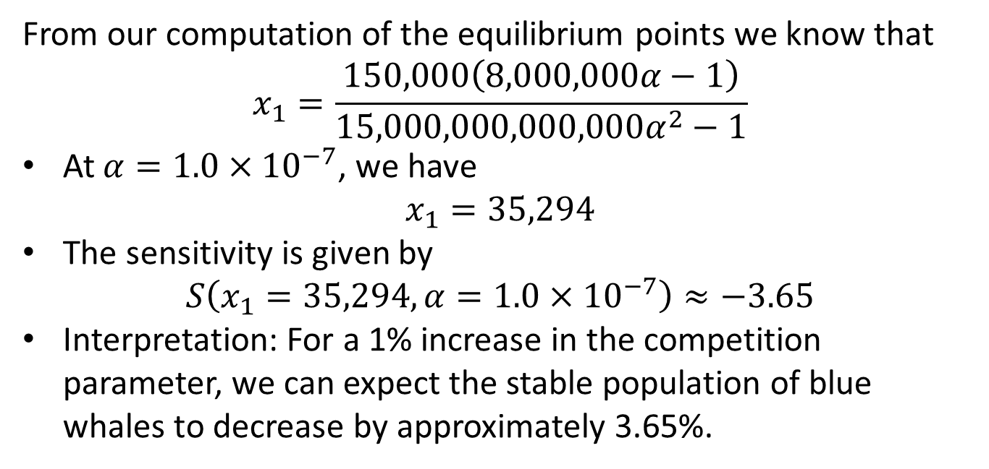
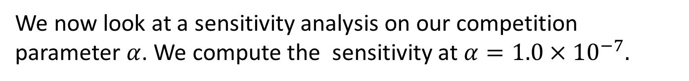
Sensitivity Analysis $x_{1}$
We now look at a sensitivity analysis on our competition parameter $α$. We compute the sensitivity at $α={1.0×10}^{−7}.$
From our computation of the equilibrium points we know that $$x_{1}=\frac{150,000\left(8,000,000α−1\right)}{15,000,000,000,000α^{2}−1}$$
At $α={1.0×10}^{−7}$, we have $x_{1}=35,294$
The sensitivity is given by $S\left(x_{1}=35,294, α=1.0×{10}^{−7}\right)≈−3.65$
Interpretation: For a 1% increase in the competition parameter, we can expect the stable population of blue whales to decrease by approximately 3.65%.

Slide 17

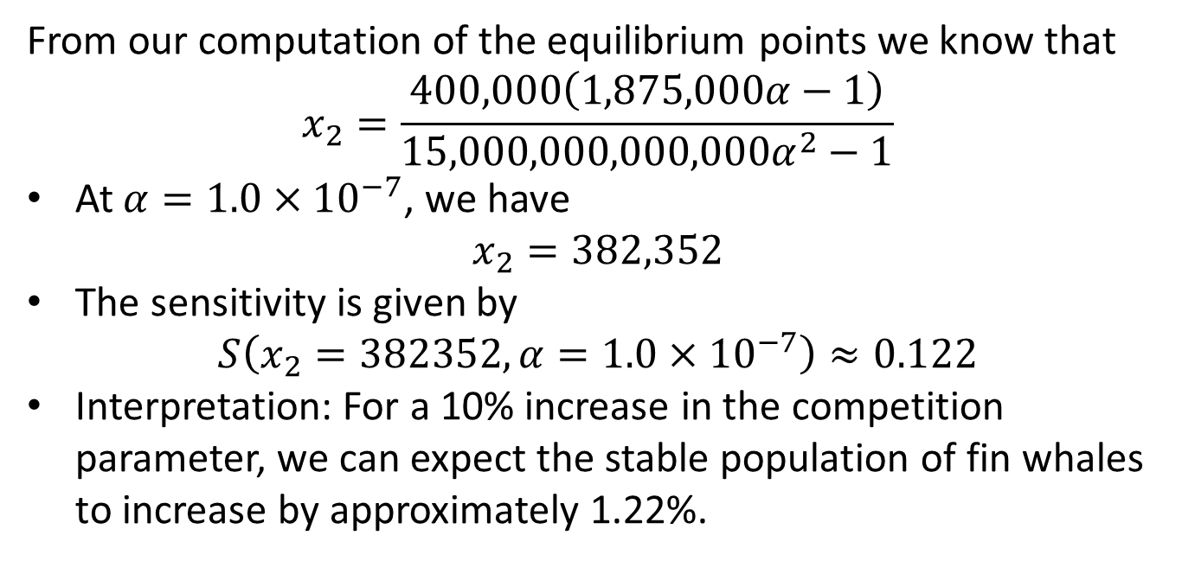
Sensitivity Analysis $x_{2}$
We now look at a sensitivity analysis on our competition parameter $α$. We compute the sensitivity at $α={1.0×10}^{−7}.$
From our computation of the equilibrium points we know that $$x_{2}=\frac{400,000\left(1,875,000α−1\right)}{15,000,000,000,000α^{2}−1}$$
At $α={1.0×10}^{−7}$, we have $x_{2}=382,352$
The sensitivity is given by $S\left(x_{2}=382352, α=1.0×{10}^{−7}\right)≈0.122$
Interpretation: For a 10% increase in the competition parameter, we can expect the stable population of fin whales to increase by approximately 1.22%.

Slide 18
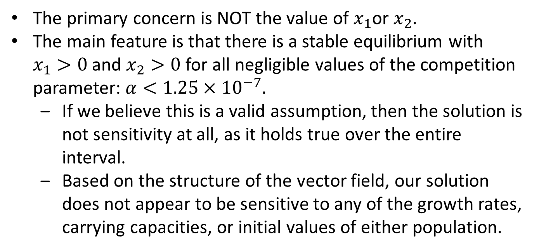
Sensitivity Conclusion
We now look at a sensitivity analysis on our competition parameter $α$. We compute the sensitivity at $α={1.0×10}^{−7}.$
The primary concern is NOT the value of $x_{1}$or $x_{2}$.
The main feature is that there is a stable equilibrium with $x_{1}>0$and $x_{2}>0$ for all negligible values of the competition parameter: $α<{1.25×10}^{−7}.$
If we believe this is a valid assumption, then the solution is not sensitivity at all, as it holds true over the entire interval.
Based on the structure of the vector field, our solution does not appear to be sensitive to any of the growth rates, carrying capacities, or initial values of either population.

Slide 19
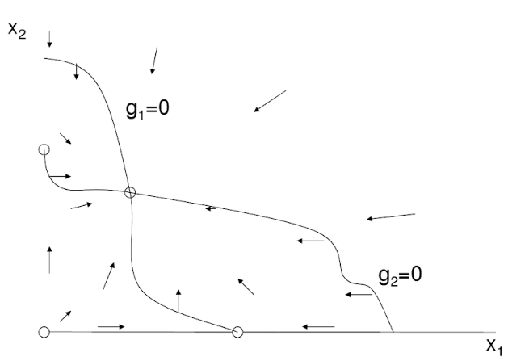
Robustness
Based on our previous discussion it appears our model is also robust.
What about the construction of the model?
Our population models can change but we need the vector field to have the same general features.

